Slide 1
The New Testament View of Creation
November 5, 2022

Slide 2
The Old Testament
The familiar texts related to creation—Genesis 1 and 2, Job 38, some psalms, etc.
Hundreds of other passages from Isaiah to the Psalms to many other references to creation.
Containing 77% of the Bible.
The New Testament has a more manageable number of texts.
How does the New Testament support or challenge the straightforward reading of the Old Testament?

Slide 3
Is There Much about creation in the New Testament?
Joel Primack and Nancy Abrams, “There is almost nothing about creation in the Gospels” (The View from the Center of the Universe, 2006, p. 57).
Well, let’s take a closer look at the New Testament and see if Primack and Abrams are right.

Slide 4
The New Testament
Every New Testament author and many New Testament characters …
Jesus
Paul
Peter
James
John
Notes:
Rio de Janeiro, Brazil, 1922-1931.

Slide 5
The New Testament
Every New Testament book except Philippians, 1 & 2 Thessalonians, Titus, Philemon, 2 John, and 3 John mentions creation.
Every chapter of Genesis except seven (20, 24, 34, 36, 40, 43, and 44) is mentioned in the New Testament.
Events from each of the first nineteen chapters of Genesis are mentioned in the New Testament.
As we look at various New Testament passages, please look for any indication of long ages or evolutionary development in living beings.

Slide 6
Some Statistics
The New Testament contains a number of passages that mention creation in one form or another. They appear as …
Echoes or allusions (53).
References to the beginning of time (10).
References to events during the creation week (38).
Significant events during creation that are dated to a recent period of history (11).
TOTAL: 112
NOTE: Some passages fit into more than one category, but I have placed each passage into one category only so as to avoid duplicates

Slide 7
“Nature”
But before we go any further, some notes on the word “nature” are helpful.
In the NIV, the word “nature” appears fourteen times in the New Testament, thirteen of them in Paul’s writings and once in Peter’s.
It refers to the divine nature (Rom. 1:20, 2 Peter 1:4), human nature or sinful nature (Rom. 7:18), the form of a servant (Phil. 2:7), or in an adverbial sense as in the phrase “by nature” (Rom. 11:24).

Slide 8
“Nature”
The word “nature” is never used to mean “the world around us” or “the universe.”
God’s word for our modern word “nature” is “creation” or “world.”
“Nature” is a secularized version of “creation.”

Slide 9
1. Echoes or allusions
John 1:1, “In the beginning…”
Rom. 8:19-22, “The creation waits in eager expectation for the sons of God to be revealed. For the creation was subjected to frustration, not by its own choice, but by the will of the one who subjected it, in hope that the creation itself will be liberated from its bondage to decay and brought into the glorious freedom of the children of God. We know that the whole creation has been groaning as in the pains of childbirth right up to the present time.”

Slide 10
1. Echoes or allusions
1 Cor. 12:18 and 24, “… God has arranged the parts in the body …” and “God has combined the members of the body and has given greater honor to the parts that lacked it …”
2 Cor. 5:17, “a new creation.”

Slide 11
1. Echoes or allusions
Eph. 2:10, “For we are God’s workmanship, created in Christ Jesus to do good works, which God prepared in advance for us to do.”
Eph. 3:9, “… this mystery, which for ages past was kept hidden in God, who created all things.”
Eph. 4:24, “… put on the new self, created to be like God …”

Slide 12
2. Brief references to the beginning of time
Matt. 24:21, the coming distress will be greater than any distress since “the beginning of the world.”
Matt. 25:34, the kingdom has been prepared since “the creation of the world.”
Mark 13:19, “… when God created the world…”

Slide 13
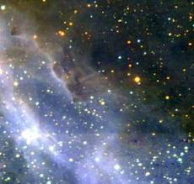
2. Brief references to the beginning of time
John 17:5 and 24, in the latter, Jesus had glory with the Father “before the creation of the world.”
Eph. 1:4, “For he chose us in him before the creation of the world…”
1 Cor. 2:7, Col. 1:18, and 1 Peter 1:20. All references to the book of Revelation will be looked at later.

Slide 14
3. References to events during the creation week (General)
John 1:3, “Through him all things were made; without him nothing was made that has been made.”
In Acts 4:24, Luke writes of God, “you made the heaven and the earth, the sea, and everything in them.”
In Acts 14:15, Paul and Barnabas are speaking to the crowd in Lystra, who had thought that the gods had come down in human form and thought Barnabas was Zeus and Paul was Hermes. They said, “Men, why are you doing this? We too are only men, human like you. We are bringing you good news, telling you to turn from these worthless things to the living God, who made heaven and earth and sea and everything in them.”

Slide 15
References to events during the creation week (general)
Acts 17:24-31 contains the sermon of Paul to the philosophers of Athens. In verses 24-26 Luke writes and Paul says,
“The God who made the world and everything in it is the Lord of heaven and earth and does not live in temples built by hands. And he is not served by human hands, as if he needed anything, because he himself gives all men life and breath and everything else. From one man he made every nation of men, that they should inhabit the whole earth; and he determined the times set for them and the exact places where they should live.”
(Note the affirmation of the first human being, who is treated as historical.)
Col. 1:15-16, “the firstborn over all creation”; “For by him all things were created”; “all things were created by him and for him”

Slide 16
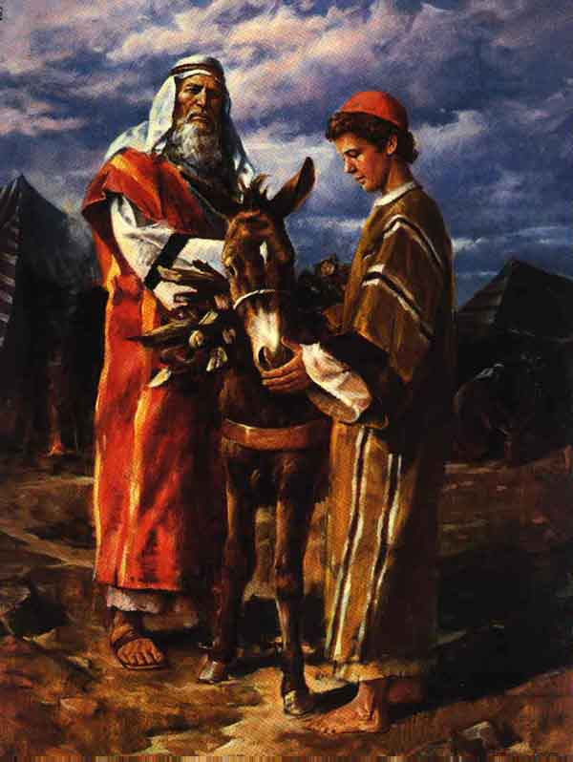
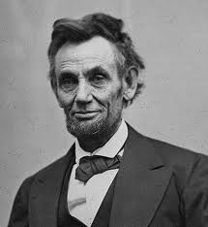
References to events during the creation week (Creation out of nothing)
Rom. 4:17 says, “He [Abraham] is our father in the sight of God, in whom he believed—the God who gives life to the dead and calls things that are not as though they were.” Better translation: “…and calls things which have no existence into existence.” (Creation out of nothing)

Slide 17
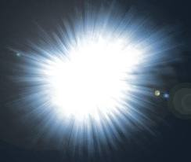
References to events during the creation week (light)
2 Cor. 4:6, “For God, who said, ‘Let light shine out of darkness,’ made his light shine in our hearts to give us the light of the knowledge of the glory of God in the face of Christ.”
Paul cites Gen. 1:3, taking it as straightforward history, and he connects the creation of light with the Gospel.

Slide 18
References to events during the creation week (Adam and Eve)
1 Cor. 11:9, “For man did not come from woman, but woman from man.” The chronology is correct: Adam, then Eve.
1 Cor. 15:38-39, “But God gives it a body as he has determined, and to each kind of seed he gives its own body. All flesh is not the same: Men have one kind of flesh, animals have another, birds another and fish another.” (Gen. 1:11, 20-27)
1 Cor. 15:45, “The first man Adam became a living being…”
1 Cor. 15:47: “The first man was of the dust of the earth…”

Slide 19
References to events during the creation week (The Image of God)
1 Cor. 11:7, Paul writes that man “is the image and glory of God.”
Col. 3:10, “… the new self, which is being renewed in knowledge in the image of its Creator.” (Gen. 1:26-27)
Heb. 2:7, God made mankind “a little lower than the angels’ and “crowned him with glory and honor.”

Slide 20
References to events during the creation week (Marriage)
1 Cor. 6:16, “For it is said, ‘The two will become one flesh.’” (Genesis 2:24)
1 Cor. 11:9, Paul states that woman was created for man.
Eph. 5:31, “‘For this reason a man will leave his father and mother and be united to his wife, and the two will become one flesh.’”

Slide 21
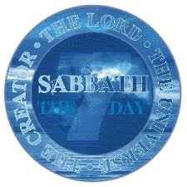
References to events during the creation week (Rest)
Heb. 4:3, “… his work has been finished since the creation of the world.”
Heb. 4:4, citing Gen. 2:2, “And on the seventh day God rested from all his work.”

Slide 22
Part 3 Summary
General references to creation
Creation out of nothing (ex nihilo)
The creation of light on Day One
The creation of Adam and Eve on Day Six
The creation of male and female in the image of God
The creation of male and female for marriage on Day Six
The resting from creative activity by God on Day Seven

Slide 23
Part 3 Summary
Three key days: Days One, Six, and Seven, and all language takes Genesis 1 and 2 in a straightforward manner.

Slide 24
4. Eleven Significant events that are dated to a recent period of history
Matt. 19:4, “’Haven’t you read,’ he replied, ‘that at the beginning the Creator made male for female,’
Matt. 19:5-6, ‘…and said, ‘For this reason a man will leave his father and mother to be united to his wife and the two will become one flesh. So they are no longer two, but one. Therefore what God has joined together, let man not separate.’”

Slide 25
4. Eleven Significant events that are dated to a recent period of history
Matt. 19:8, “… it was not this way from the beginning.” (on divorce)
Mark 10:6 (see two slides ahead, = Matt. 19:4-6)
Mark 10:7-8, “For this reason a man will leave his father and mother and be united to his wife, and the two will become one flesh.” So they are no longer two, but one. Therefore what God has joined together, let man not separate.

Slide 26
4. TeN Significant events that are dated to a recent period of history
Luke 11:50-51, Jesus connects the murder of Abel to the foundation of the world, i.e. its creation, not to an event that happened millions of years later.
Rom. 1:20, “For since the creation of the world God’s invisible qualities—his eternal power and divine nature—have been clearly seen, being understood from what has been made, so that men are without excuse.” This implies that people have been around since the creation of the world, as was already suggested in Matt. 19:4-6 and Mark 10:6.
Heb. 9:26, “Then Christ would have had to suffer many times since the creation of the world.”

Slide 27
Timelines
Mark 10:6, “But at the beginning of creation God ‘made them male and female.’”
Darwinian Evolution: 14.6 billion years
Old Earth Creationism: 14.6 billion years
Young Earth Creationism: < 10,000 years
The beginning of time
Right now

Slide 28
The Devil
John 8:44, the devil was “a murderer from the beginning.”
1 John 3:8, “He who does what is sinful is of the devil, because the devil has been sinning from the beginning.”
As we read Genesis 1-3, we are not given a clear chronology, but we get the impression that the Fall happened relatively soon after the completion of creation. Chapter three follows immediately after chapter two with no intervening phrase, such as “After some time” or “Many years later.”
Therefore, if the devil was a murderer from the beginning, he was around at the beginning and the story of the Fall happened near the beginning.

Slide 29
Ten Significant events during creation that are dated to a recent period of history
11. Jude 14, “Enoch, the seventh from Adam, prophesied…”
Adam, Gen. 5:3
Seth, Gen. 5:6
Enosh, Gen. 5:9
Kenan, Gen. 5:12
Mahalalel, Gen. 5:15
Jared, Gen. 5:18
Enoch, Gen. 5:21
See also 1 Chron. 1:1-3, “Adam, Seth, Enosh, Kenan, Mahalalel, Jared, Enoch, Methuselah, Lamech, Noah.”

Slide 31
Pastoral epistles
1 Tim. 2:13, “… Adam was formed first, then Eve.” Note the same order of creation as in Genesis 1.
1 Tim. 4:3, “…abstain from certain foods, which God created to be received with thanksgiving…”
1 Tim. 4:4, “For everything God created is good…” (Gen. 1:10, 12, 21, 25, “And God saw that it was good.”)
1 Tim. 6:13, “… God, who gives life to everything …”

Slide 32
Hebrews
Heb. 1:2, “… his Son … through whom he made the universe.”
Heb. 1:10, “In the beginning, O Lord, you laid the foundations of the earth, and the heavens are the work of your hands.”
Heb. 2:7, “You made him a little lower than the angels…”
Heb. 3:4, “… God is the builder of everything.”
Heb. 11:3, “By faith we understand that the universe was formed at God’s command, so that what is seen was not made out of what was visible.” (Creation out of nothing, commonly called creatio ex nihilo.) (And Heb. 4:4, 10, 13, 9:11, 26)

Slide 33
General epistles
James 1:18, “He chose to give us birth through the word of truth, that we might be a kind of firstfruits of all he created.”
James 3:9, “With the tongue we praise our Lord and Father, and with it we curse men, who have been made in God’s likeness.”
1 Peter 4:19, “… should commit themselves to their faithful Creator …”
2 Peter 3:4-5, “They will say, ‘Where is this “coming” he promised? Ever since our fathers died, everything goes on as it has since the beginning of creation.’ But they deliberately forget that long ago by God’s word the heavens existed and the earth was formed out of water and by water.”

Slide 34
revelation
The New Testament book
with the most references to creation is
the book of Revelation—a total of twenty-one!
Rev. 1:8, “the Almighty,” the Pantokrator (also 4:8, 11:17, 15:3, 16:7, 14, 19:6, 15, and 21:22)
Rev. 2:7 (Gen. 2:9), “I will give the right to eat from the tree of life, which is in the paradise of God.”

Slide 35
revelation
Rev. 3:14, “These are the words of the Amen, the faithful and true witness, the ruler of God’s creation.”
Rev. 4:11 (Gen. 1 and 2:3), “…for you created all things, and by your will they were created and have their being.”
Rev. 5:13, “Then I heard every creature in heaven and on earth and under the earth and on the sea, and all that is in them, singing.”
Rev. 8:9, “… a third of the living creatures in the sea…”

Slide 36
revelation
Rev. 10:6 (Gen. 2:1), “…who created the heavens and all that is in them, the earth and all that is in it, and the sea and all that is in it…”
Rev. 13:8, the Lamb “was slain from the creation of the world.”
Rev. 14:7 (Gen. 2:4), “Worship him who made the heavens, the earth, the sea and the springs of water.”
Rev. 17:8, some have not had their names written in the book of life “from the creation of the world.”

Slide 37
revelation
Rev. 22:2, “… the tree of life …”
Rev. 22:14 (Gen. 2:9), “… the right to the tree of life …”
Rev. 22:19, “… the tree of life …”
Add eight references to this number for the word “Almighty.”

Slide 38
conclusion
John: 28 references in his five books
Paul: 44 references in his thirteen letters
The four Gospels: 17 references
Hebrews: 11 references
Revelation: 21 references

Slide 39
conclusion
At the start, I stated, “As we look at various New Testament passages, please look for any indication of long ages or evolutionary development in living beings.” Did you see any?
And does this presentation convince you that the New Testament is deeply interested in creation?
Is it really sufficient to attempt to divide and conquer and say, “Well, the New Testament is concerned about theology rather than history or chronology”?

Slide 40
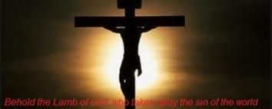
Soli Deo Gloria

